Slide 1
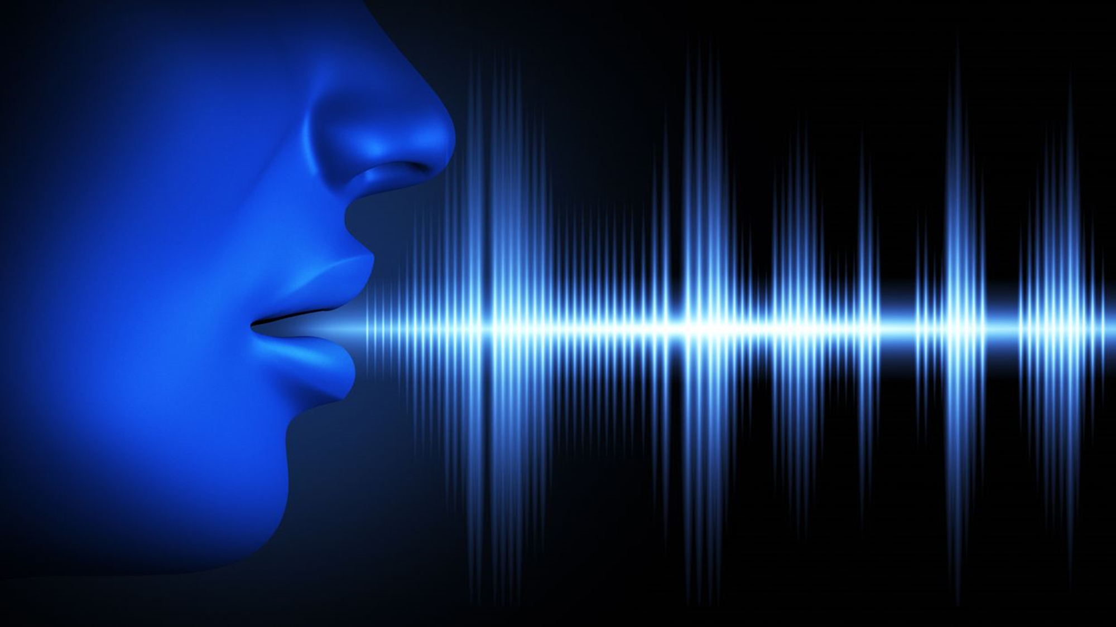
voice recognition for authentication
​MEMBERS
Roll.no. Name Register.No.
1. Abhaya Das B LBT20CS001
14. Anjana A.P LBT20CS014
25. Ashritha Menon LBT20CS025
29. Aysha Najeem LBT20CS029
GUIDE
Prof. Raji Ramachandran
Dept Of CSE,
LBSITW
REVIEW 1

Slide 2


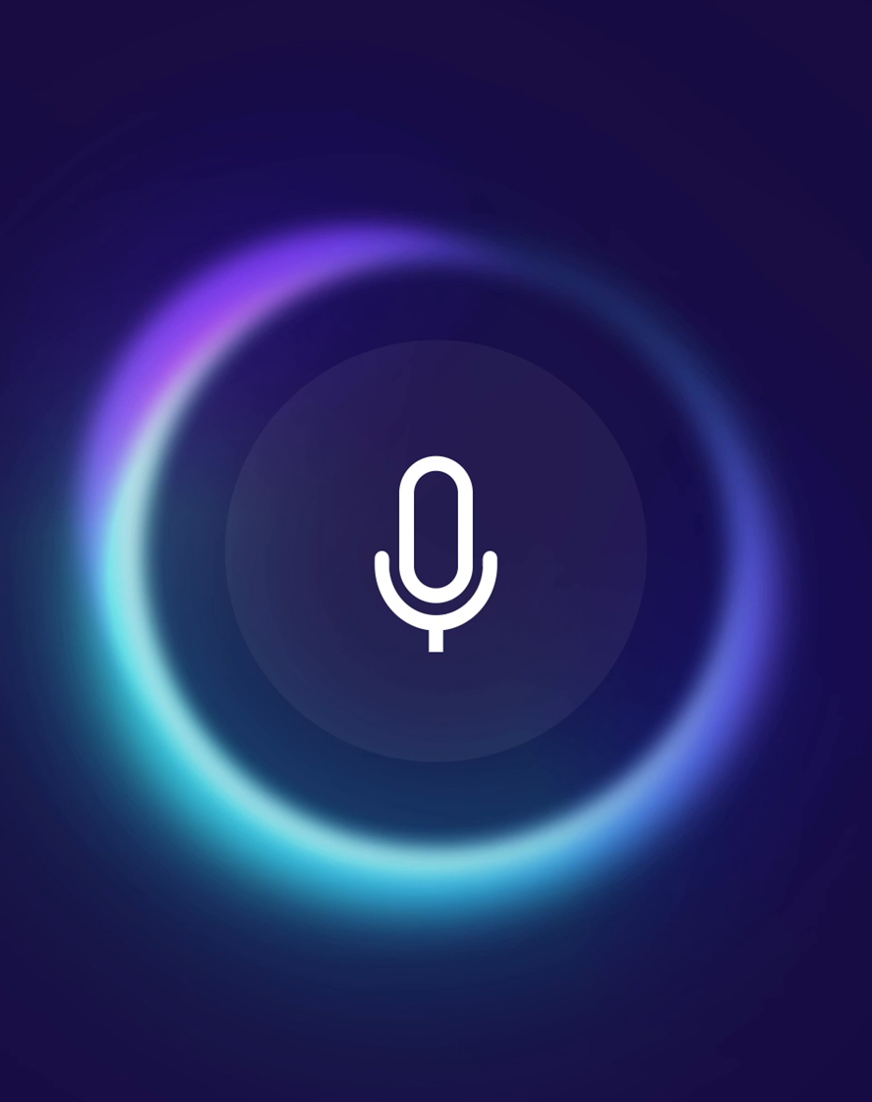
PROBLEM STATEMENT
Authentication methods like pattern passwords are insecure and can be easily hacked or stolen.
We aim to provide a more secure and efficient authentication system, that eliminates the need for vulnerable traditional methods.
Advanced machine learning algorithms are used to analyze and differentiate different voice patterns.
Goal: To create a reliable, secure and efficient system that protects sensitive information and improves user experience.
Aims to achieve security, without the need for additional sensors used in other biometric authentication methods.
INTRODUCTION:
Artificial intelligence has started to outsmart humans, and so pattern password and pins have become increasingly vulnerable.
Biometric based authentication like voice recognition has thus become an essential technology for enabling security and for protecting sensitive information.
Features of portability, stability, and privacy of the voice features, are responsible for its vast growth.
Considered accurate and does not require specialized tools.
Voice is the simplest and easiest unimodal that supports authentication.
The project aims to identify and verify users based on their unique voice pattern; there by increasing the ease and convenience of ensuring security without compromising the safety.
OBJECTIVES:
Develop a robust and accurate voice biometric system that can identify and authenticate users based on their voice patterns.
Enhance user experience by providing a convenient, fast and hands-free authentication method.
Improve security measures by providing a highly accurate and difficult-to-replicate means of authentication.
Ensure that the system is scalable and adaptable to the needs of different organizations and systems.
To conduct several testing and evaluation to ensure the system is reliable, secure and accurate.

Slide 3
INTRODUCTION:
Artificial intelligence has started to outsmart humans, and so pattern password and pins have become increasingly vulnerable.
Biometric based authentication like voice recognition has thus become an essential technology for enabling security and for protecting sensitive information.
Features of portability, stability, and privacy of the voice features, are responsible for its vast growth.
Considered accurate and does not require specialized tools.
Voice is the simplest and easiest unimodal that supports authentication.
The project aims to identify and verify users based on their unique voice pattern; there by increasing the ease and convenience of ensuring security without compromising the safety.
PROBLEM STATEMENT
Authentication methods like pattern passwords are insecure and can be easily hacked or stolen.
We aim to provide a more secure and efficient authentication system, that eliminates the need for vulnerable traditional methods.
Advanced machine learning algorithms are used to analyze and differentiate different voice patterns.
Goal: To create a reliable, secure and efficient system that protects sensitive information and improves user experience.
Aims to achieve security, without the need for additional sensors used in other biometric authentication methods.
OBJECTIVES:
Develop a robust and accurate voice biometric system that can identify and authenticate users based on their voice patterns.
Enhance user experience by providing a convenient, fast and hands-free authentication method.
Improve security measures by providing a highly accurate and difficult-to-replicate means of authentication.
Ensure that the system is scalable and adaptable to the needs of different organizations and systems.
To conduct several testing and evaluation to ensure the system is reliable, secure and accurate.

Slide 4
INTRODUCTION:
Artificial intelligence has started to outsmart humans, and so pattern password and pins have become increasingly vulnerable.
Biometric based authentication like voice recognition has thus become an essential technology for enabling security and for protecting sensitive information.
Features of portability, stability, and privacy of the voice features, are responsible for its vast growth.
Considered accurate and does not require specialized tools.
Voice is the simplest and easiest unimodal that supports authentication.
The project aims to identify and verify users based on their unique voice pattern; there by increasing the ease and convenience of ensuring security without compromising the safety.
OBJECTIVES:
Develop a robust and accurate voice biometric system that can identify and authenticate users based on their voice patterns.
Enhance user experience by providing a convenient, fast and hands-free authentication method.
Improve security measures by providing a highly accurate and difficult-to-replicate means of authentication.
Ensure that the system is scalable and adaptable to the needs of different organizations and systems.
To conduct several testing and evaluation to ensure the system is reliable, secure and accurate.
PROBLEM STATEMENT
Authentication methods like pattern passwords are insecure and can be easily hacked or stolen.
We aim to provide a more secure and efficient authentication system, that eliminates the need for vulnerable traditional methods.
Advanced machine learning algorithms are used to analyze and differentiate different voice patterns.
Goal: To create a reliable, secure and efficient system that protects sensitive information and improves user experience.
Aims to achieve security, without the need for additional sensors used in other biometric authentication methods.

Slide 5

The data used in this paper are drawn from the english language speech database for speaker recognition (ELSDSR) database which composes of audio files for training and other files for testing. The performance of the proposed system is evaluated by using the test files. The proposed method showed efficiency results were better than the well-known Mel Frequency Cepstral Coefficient (MFCC) and the Zak transform.
"Stand-alone intelligent voice recognition system" by Mohammed R. Saady, Hatem El-Borey, El-Sayed A. El-Dahshan, Ashraf Shamseldin Yahia.
LITERATURE REVIEW
PAPER:
“Text independent biometric authentication system based on voice recognition" by Mohammad Akhtar.
DESCRIPTION:
The system uses mel frequency cepstrum coefficient (MFCC) to extract speech features. Universal Background Model (UBM) is used as an alternate model for likelihood ratio testing for authentication.
PROS:
UBM models can be adapted to new speakers, allowing the creation of new speaker models, without retraining the entire system.
CONS:
Large amount of data is required for accurate training.
Gathering and processing of data can become very expensive.
"Voice biometric identity authentication model for IOT devices" by Salahaldeen Duraibi, Frederick T. Sheldon and Wasim Alhamdani.
In this paper, a voice recognition authentication system to be used in the IOT ecosystem is proposed. The proposed system uses of MFCC to extract features, and Support Vector Machines (SVMs) for user verification
PROS | CONS
Processing speed of the voice enhancement method using ANN-noise and more efficient. Feature extraction was done using Wavelet Packet Transform (WPT), which gave an accuracy of 95.7% | Increased number of features associated with each speaker, not much efficient if the system is used in the real-time where the noise exist such as the street.
PROS | CONS
IoT ecosystem related advantage of voice biometric include requiring of small storage, ease of transmission, and non-intrusiveness is benefitted. | Most of the tools and algorithms proposed or promoted for the use in the system are not technically evaluated.

Slide 6
LITERATURE REVIEW
"Text independent biometric authentication system based on voice recognition" by Mohammad Akhtar.
The system uses mel frequency cepstrum coefficient (MFCC) to extract speech features. Universal Background Model (UBM) is used as an alternate model for likelihood ratio testing for authentication.
PAPER:
“Voice Recognition Control System Based on Cloud Computing and IoT Sensors" by Xueya Song and Shengchao Sun
DESCRIPTION:
This method firstly tests the existing home appliance network of the smart home voice control system to verify the feasibility of the author’s design. Then, the voice recognition task is transferred to the cloud server, and the smart home Internet gateway only needs to perform data upload, command execution, and protocol analysis.
PROS:
Processing speed of the voice enhancement method using ANN-noise and more efficient. Feature extraction was done using Wavelet Packet Transform (WPT), which gave an accuracy of 95.7%
CONS:
Processing speed of the voice enhancement method using ANN-noise and more efficient. Feature extraction was done using Wavelet Packet Transform (WPT), which gave an accuracy of 95.7%
"Voice biometric identity authentication model for IOT devices" by Salahaldeen Duraibi, Frederick T. Sheldon and Wasim Alhamdani.
In this paper, a voice recognition authentication system to be used in the IOT ecosystem is proposed. The proposed system uses of MFCC to extract features, and Support Vector Machines (SVMs) for user verification
PROS | CONS
UBM models can be adapted to new speakers, allowing the creation of new speaker models, without retraining the entire system. | Large amount of data is required for accurate training. Gathering and processing of data can become very expensive.
PROS | CONS
IoT ecosystem related advantage of voice biometric include requiring of small storage, ease of transmission, and non-intrusiveness is benefitted. | Most of the tools and algorithms proposed or promoted for the use in the system are not technically evaluated.

Slide 7
LITERATURE REVIEW
"Text independent biometric authentication system based on voice recognition" by Mohammad Akhtar.
The system uses mel frequency cepstrum coefficient (MFCC) to extract speech features. Universal Background Model (UBM) is used as an alternate model for likelihood ratio testing for authentication.
PAPER:
"Voice biometric identity authentication model for IOT devices" by Salahaldeen Duraibi, Frederick T. Sheldon and Wasim Alhamdani.
DESCRIPTION:
In this paper, a voice recognition authentication system to be used in the IoT ecosystem is proposed. The resource limitedness of the IoT devices and remote access are taken into consideration.
"Stand-alone intelligent voice recognition system" by Mohammed R. Saady, Hatem El-Borey, El-Sayed A. El-Dahshan, Ashraf Shamseldin Yahia.
PROS:
Remote voice control of the smart home system
Speech enhancement.
CONS:
Dependency on Internet Connectivity
Complexity and Cost
The data used in this paper are drawn from the english language speech database for speaker recognition (ELSDSR) database which composes of audio files for training and other files for testing. The performance of the proposed system is evaluated by using the test files. The proposed method showed efficiency results were better than the well-known Mel Frequency Cepstral Coefficient (MFCC) and the Zak transform.
PROS | CONS
Processing speed of the voice enhancement method using ANN-noise and more efficient. Feature extraction was done using Wavelet Packet Transform (WPT), which gave an accuracy of 95.7% | Increased number of features associated with each speaker, not much efficient if the system is used in the real-time where the noise exist such as the street.
PROS | CONS
UBM models can be adapted to new speakers, allowing the creation of new speaker models, without retraining the entire system. | Large amount of data is required for accurate training. Gathering and processing of data can become very expensive.

Slide 8
LITERATURE REVIEW
"Text independent biometric authentication system based on voice recognition" by Mohammad Akhtar.
The system uses mel frequency cepstrum coefficient (MFCC) to extract speech features. Universal Background Model (UBM) is used as an alternate model for likelihood ratio testing for authentication.
PAPER:
“Voice Biometric: A Technology for Voice Based Authentication” by Nilu Singh, Alka Agrawal, and R. A. Khan.
DESCRIPTION:
This paper presents a review dealing with the process of recognizing human beings from biometric data.
"Stand-alone intelligent voice recognition system" by Mohammed R. Saady, Hatem El-Borey, El-Sayed A. El-Dahshan, Ashraf Shamseldin Yahia.
PROS:
Convenience, increased security and accuracy
Non imitative, non-sharable, cannot be lost
Reduced paper work, easy to access
CONS:
Offensive of privacy
Cost of implementation
The data used in this paper are drawn from the english language speech database for speaker recognition (ELSDSR) database which composes of audio files for training and other files for testing. The performance of the proposed system is evaluated by using the test files. The proposed method showed efficiency results were better than the well-known Mel Frequency Cepstral Coefficient (MFCC) and the Zak transform.
PROS | CONS
Processing speed of the voice enhancement method using ANN-noise and more efficient. Feature extraction was done using Wavelet Packet Transform (WPT), which gave an accuracy of 95.7% | Increased number of features associated with each speaker, not much efficient if the system is used in the real-time where the noise exist such as the street.
PROS | CONS
UBM models can be adapted to new speakers, allowing the creation of new speaker models, without retraining the entire system. | Large amount of data is required for accurate training. Gathering and processing of data can become very expensive.

Slide 9
LITERATURE REVIEW
"Text independent biometric authentication system based on voice recognition" by Mohammad Akhtar.
The system uses mel frequency cepstrum coefficient (MFCC) to extract speech features. Universal Background Model (UBM) is used as an alternate model for likelihood ratio testing for authentication.
PAPER:
“Person Authentication by Voice: A Need for Caution” by Jean-François Bonastre, Frédéric Bimbot, Louis-Jean Boë, Joseph P. Campbell, Douglas A. Reynolds, Ivan Magrin-Chagnolleau.
DESCRIPTION:
This paper is intended to offer clear information to journalists, as well as the general public, concerning the possibility of identifying or authenticating a person by his or her voice.
"Stand-alone intelligent voice recognition system" by Mohammed R. Saady, Hatem El-Borey, El-Sayed A. El-Dahshan, Ashraf Shamseldin Yahia.
PROS:
Convenience, increased security and accuracy.
Speech enhancement.
CONS:
There is no control over recording equipment.
Recording conditions are not known.
The linguistic content of the message is not controlled.
The data used in this paper are drawn from the english language speech database for speaker recognition (ELSDSR) database which composes of audio files for training and other files for testing. The performance of the proposed system is evaluated by using the test files. The proposed method showed efficiency results were better than the well-known Mel Frequency Cepstral Coefficient (MFCC) and the Zak transform.
PROS | CONS
Processing speed of the voice enhancement method using ANN-noise and more efficient. Feature extraction was done using Wavelet Packet Transform (WPT), which gave an accuracy of 95.7% | Increased number of features associated with each speaker, not much efficient if the system is used in the real-time where the noise exist such as the street.
PROS | CONS
UBM models can be adapted to new speakers, allowing the creation of new speaker models, without retraining the entire system. | Large amount of data is required for accurate training. Gathering and processing of data can become very expensive.

Slide 10
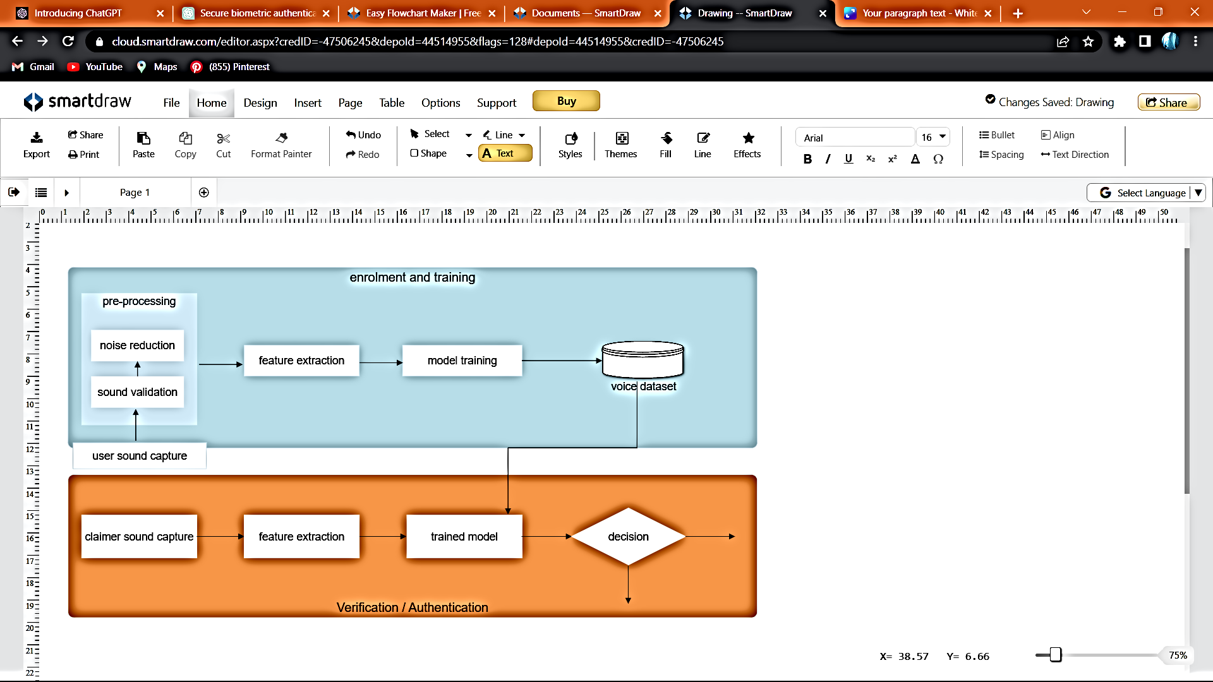
DESIGN AND IMPLEMENTATION
FLOW DIAGRAM
true
success
false
fail

Slide 11

ALGORITHM
K-Nearest Neighbors (KNN)
The K-Nearest Neighbors (KNN) algorithm is a popular machine learning algorithm used for classification tasks, including audio file analysis. It is a non-parametric method that relies on the principle of similarity to classify new instances based on their proximity to known instances in the training dataset.
How It Works
Advantages
Simplicity
NO Training Phase
Non-Parametric
Adaptability
Robustness to Noise
Feature Extraction
Training Phase
Classification
Voting or weighted voting
Methodology:
GMM:
GMM can learn a statistical model for each known speaker using their speech signal. The GMM can then be used to calculate the likelihood of the unknown speaker to each of the known speaker models. The speaker with the highest likelihood can be identified as the claimed one.
SVM:
SVM can learn to separate the speech signal of each known speaker using a hyperplane in the feature space. The algorithm can learn to identify the decision boundary that maximizes the margin between the speaker classes. When an unknown speaker's speech signal is given as input, the algorithm can use the learned hyperplane to determine which known speaker the input speech signal belongs to.

Slide 12
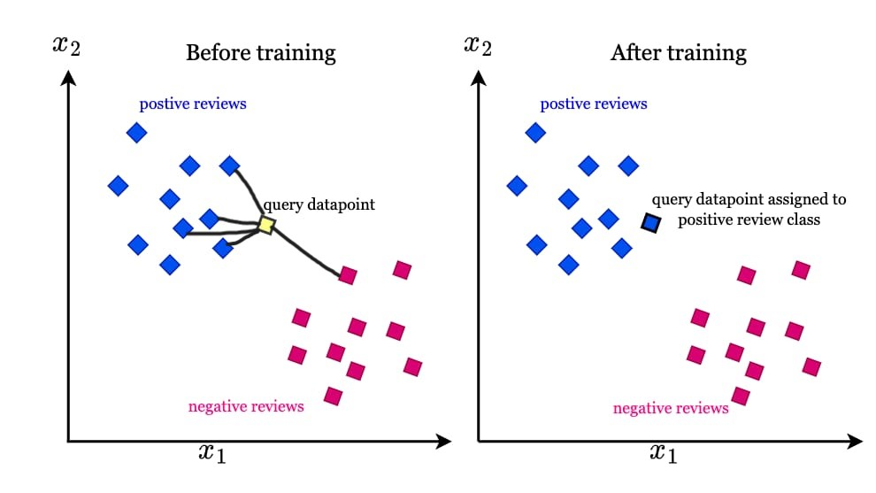
DEMONSTRATION OF WORKING OF KNN

Slide 13

Methodology:
DATASET:
In this project, we train the model using a few voice samples from the dataset "VOXCELEB 1". The voice samples available here were pre-processed to remove noise and other distortions. The voice sample will be transformed into a set based on features like frequency, amplitude and Mel-Frequency Cepstral Coefficients or MFCC.
ALGORITHM:
These features will be then fed into a machine learning algorithm. We are aiming to work with two algorithms: Support Vector Machine or SVM algorithm and Gaussian Mixture Model or GMM, and to finally implement the one which is found to be more accurate.
IMPLEMENTATION:
Feature Extraction using MFCC: This technique involves extraction the key features like spectral content and temporal dynamics from each voice samples.
Data Collection and Training: Around 90 voice samples of 5 seconds each of 3 users was converted into wav file and fed into a model.
Real-time Audio Recording and Authentication: Live audio of users can be taken as input and feeded into the trained model for authentication.
Performance Evaluation and Future Improvements: We plan to improve the accuracy of the model by training more voice samples to the model and performing better noise reduction.

Slide 14

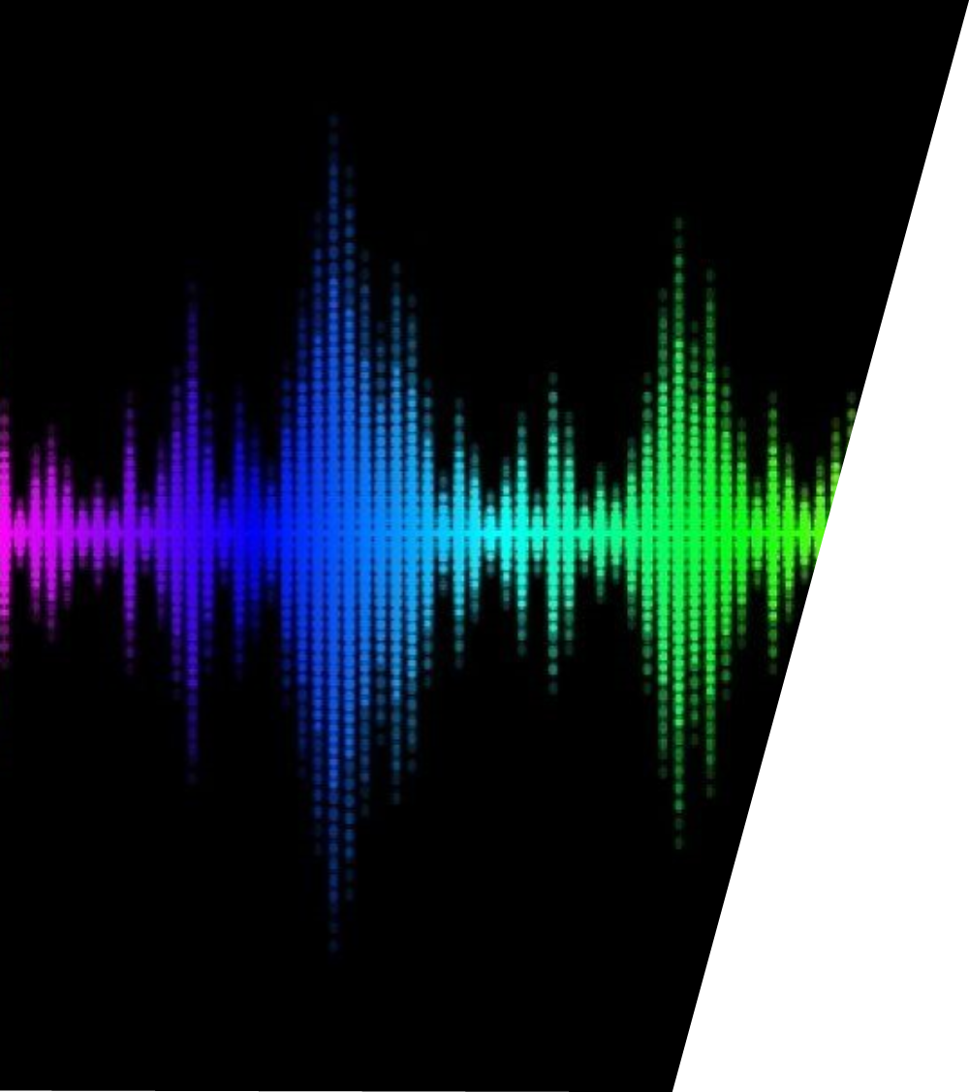

ADVANTAGES OF OUR PROJECT:
Voice authentication may provide a more convenient and user friendly way to access devices and system.
There is no need for additional hardware like sensors.
It can provide a higher level of security compared to the traditional methods.
It can be used in a variety of industries, such as healthcare, finance etc.
CONCLUSION:
The project involves machine learning algorithms to identify and verify the speakers voice by analyzing several speech features such as tone, pitch and frequency. The system can be used in various applications such as unlocking smartphones, accessing secure facilities, and making financial transactions. Overall, the voice recognition and authentication systems have the potential to enhance security and convenience in several areas of our daily lives.
REFERENCES:
N. J. Perdana, D.E. Herwindiati and N. H. Sarmin, “Voice Recognition System for User Authentication Using Gaussian Mixture Model”, 2022 IEEE International Conference on Artificial Intelligence in Engineering and Technology (IICAIET), Kota Kinabalu, Malaysia, 2022
P. H. Chandankhede, A. S. Titarmare and S. Chauhvan, “Voice Recognition Based Security System Using Convolutional Neural Network”, 2021 International Conference on Computing, Communication, and Intelligent Systems (ICCCIS), Greater Noida, India, 2021
K. Khotimah et al., "Validation of Voice Recognition in Various Google Voice Languages using Voice Recognition Module V3 Based on Microcontroller," 2020 Third International Conference on Vocational Education and Electrical Engineering (ICVEE), Surabaya, Indonesia, 2020, pp. 1-6, doi: 10.1109/ICVEE50212.2020.9243184.

Slide 15
ADVANTAGES OF OUR PROJECT:
Voice authentication may provide a more convenient and user friendly way to access devices and system.
There is no need for additional hardware like sensors.
It can provide a higher level of security compared to the traditional methods.
It can be used in a variety of industries, such as healthcare, finance etc.
CONCLUSION:
The project involves machine learning algorithms to identify and verify the speakers voice by analyzing several speech features such as tone, pitch and frequency. The system can be used in various applications such as unlocking smartphones, accessing secure facilities, and making financial transactions. Overall, the voice recognition and authentication systems have the potential to enhance security and convenience in several areas of our daily lives.
REFERENCES:
N. J. Perdana, D.E. Herwindiati and N. H. Sarmin, “Voice Recognition System for User Authentication Using Gaussian Mixture Model”, 2022 IEEE International Conference on Artificial Intelligence in Engineering and Technology (IICAIET), Kota Kinabalu, Malaysia, 2022
P. H. Chandankhede, A. S. Titarmare and S. Chauhvan, “Voice Recognition Based Security System Using Convolutional Neural Network”, 2021 International Conference on Computing, Communication, and Intelligent Systems (ICCCIS), Greater Noida, India, 2021
K. Khotimah et al., "Validation of Voice Recognition in Various Google Voice Languages using Voice Recognition Module V3 Based on Microcontroller," 2020 Third International Conference on Vocational Education and Electrical Engineering (ICVEE), Surabaya, Indonesia, 2020, pp. 1-6, doi: 10.1109/ICVEE50212.2020.9243184.

Slide 16
ADVANTAGES OF OUR PROJECT:
Voice authentication may provide a more convenient and user friendly way to access devices and system.
There is no need for additional hardware like sensors.
It can provide a higher level of security compared to the traditional methods.
It can be used in a variety of industries, such as healthcare, finance etc.
REFERENCES:
N. J. Perdana, D.E. Herwindiati and N. H. Sarmin, “Voice Recognition System for User Authentication Using Gaussian Mixture Model”, 2022 IEEE International Conference on Artificial Intelligence in Engineering and Technology (IICAIET), Kota Kinabalu, Malaysia, 2022
P. H. Chandankhede, A. S. Titarmare and S. Chauhvan, “Voice Recognition Based Security System Using Convolutional Neural Network”, 2021 International Conference on Computing, Communication, and Intelligent Systems (ICCCIS), Greater Noida, India, 2021
K. Khotimah et al., "Validation of Voice Recognition in Various Google Voice Languages using Voice Recognition Module V3 Based on Microcontroller," 2020 Third International Conference on Vocational Education and Electrical Engineering (ICVEE), Surabaya, Indonesia, 2020
CONCLUSION:
The project involves machine learning algorithms to identify and verify the speakers voice by analyzing several speech features such as tone, pitch and frequency. The system can be used in various applications such as unlocking smartphones, accessing secure facilities, and making financial transactions. Overall, the voice recognition and authentication systems have the potential to enhance security and convenience in several areas of our daily lives.
[1]
[2]
[3]

Slide 17

THANK YOU

